Slide 1

A Presentation on KeyDash
Research Management Cell
POKHARA ENGINEERING COLLEGE
Phirke, Pokhara-8
(July, 2025)
Submitted by:
Anurag Ale
Britant Shrestha
Manish Shrestha
Ranjana Dhakal
Supervised by:
Anil Timilsina

Slide 2
INTRODUCTION
In today's digital age, typing speed and accuracy are essential skills for students, professionals, and casual users alike.
"KeyDash" is a web-based application designed to evaluate typing speed in words per minute (WPM) and accuracy while providing a user-friendly interface.
Notes:
Students (taking notes, writing assignments).
Professionals (emails, coding, reports).
Casual users (social media, messaging).
A web-based app (accessible via browsers, no installation needed).
User-Friendly Interface: Easy to navigate, clean design.

Slide 3
PROBLEM STATEMENT
Real-time, accurate evaluation of typing speed (WPM) and error rate.
Designing a user interface that is both visually appealing and intuitive.
Implementing a system to store and retrieve user performance history.
Ensuring responsiveness and cross-device compatibility.
Notes:
Many typing tools rely on old UI frameworks, leading to:
Poor mobile/tablet compatibility.

Slide 4
OBJECTIVES
The primary objectives of KeyDash are:
KeyDash offers real time wpm and diverse text sources, allowing users to tailor difficulty levels to their typing skills.
KeyDash provides leaderboard to compete between users.

Slide 5
LITERATURE REVIEW
Current platforms like 10FastFingers and TypingClub provide basic WPM and accuracy tests .
Traditional typing practice methods are often unsystematic and do not offer real-time feedback, personalized analytics, or long-term performance monitoring.
KeyDash bridges these gaps by offering real-time analytics, and user progress tracking through Supabase — all in an accessible, user-friendly web interface.

Slide 6
METHODOLOGY
Software Used:
Frontend: HTML, React.js (Routing, components), Tailwindcss for styling.
Version Control: GitHub (branches, pull requests).
Design: Figma
Backend: Supabase
Deployment: Vercel
Notes:
Agile development :flexible and iterative methodology for software development.
Why
Faster delivery of usable feature., better respone to changes., improves teamwork and provides transparency

Slide 7
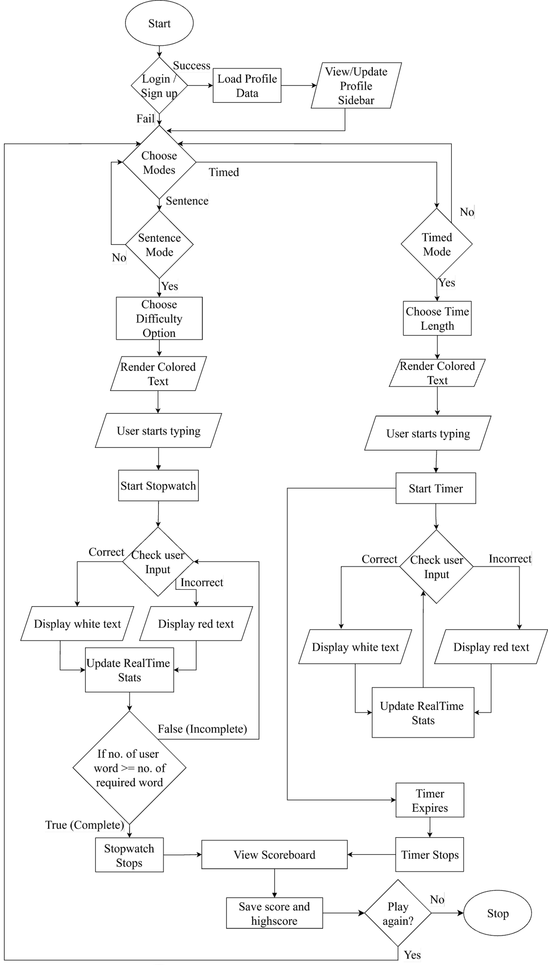
FLOWCHART:

Slide 8
Challenges Encountered
Real-Time Feedback: Achieving accurate and responsive real-time WPM and accuracy updates required fine-tuning.
Overlapping Text area with Display Text: Making the textarea and updating the display text to white for correct characters and red for incorrect characters was a hassle.
Text Randomization: Ensuring random yet grammatically coherent paragraph generation.

Slide 9
TESTING
S.N. | Test Case Summary | Results
1 | To test whether it displays differently to incorrect character. | Passed
2 | To test whether it displays real time WPM meter. | Passed
3 | To test whether it displays score and graph. | Passed
4 | To test whether it displays leaderboard. | Passed
5 | To test whether it keeps the record of the user progress or not. | Passed
6 | To test whether it displays error page in case of invalid URL. | Passed
To ensure the reliability and effectiveness of keydash, various test cases were executed during development process.
The testing focuses on the effective calculation of WPM, display of errors and delivering real-time alerts to user.
Testing was conducted on multiple devices.
The application performed well across all essential features and behaves consistently under different scenario.

Slide 10
Conclusion
Overall, KeyDash demonstrates the effective application of full-stack development principles to create a functional and scalable typing assessment tool. The project not only fulfills its core objective of evaluating typing speed but also showcases the potential for expansion with features like customized practice texts, and detailed performance insights.

Slide 11
REFERENCES
10FastFingers: Website: https://10fastfingers.com
Typeshala: Website: http://typeshala.shresthasushil.com.np/
Rogers, R. D., & Monsell, S. (1995). Costs of a predictable switch between simple cognitive tasks. Journal of Experimental Psychology: General, 124(2), 207–231.
Chen, Y., Chen, Y., & Huang, Y. (2021). Adaptive feedback systems and their impact on learning performance: A meta-analysis. Computers & Education, 174, 104309.
Zhang, L., & Sun, T. (2023). Real-time feedback systems in typing tutors: A WebSocket-based approach. Journal of Educational Technology & Society, *26*(1), 89-102.

Slide 12
THANK YOU

